Slide 1
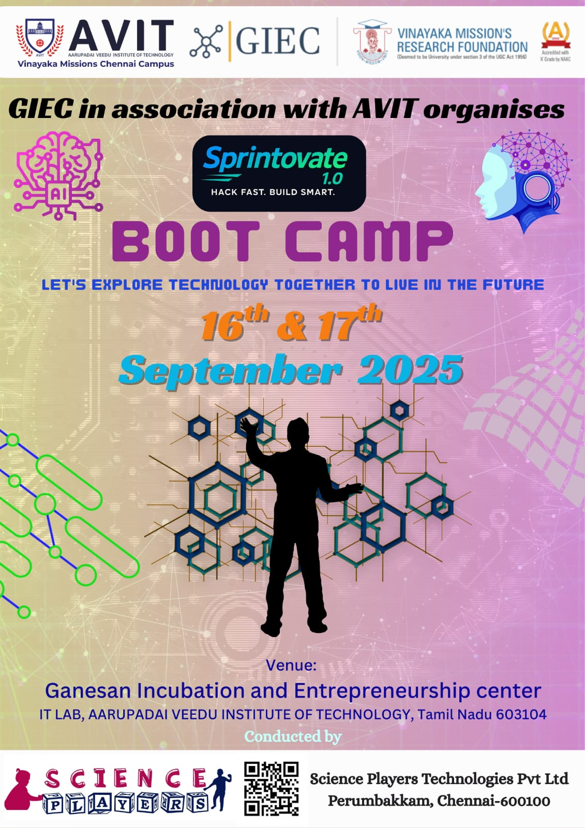




Slide 2
ML BASED CARDIAC RISK SCORE PREDICTOR
Team members:
MEKALA NARENDRA KUMAR
CHINTHA SANJEEV KOUSHIK KUMAR REDDY
HARISH

Slide 3
PROBLEM STATEMENT
Cardiovascular diseases are a leading cause of death globally, often going undetected until serious events occur. This project aims to develop a machine learning-based system that uses data from wearable sensors to predict a user’s cardiac risk score in real time. By analyzing physiological signals like ECG and heart rate, the system will provide early warnings through a user-friendly dashboard, enabling timely intervention and remote monitoring.

Slide 4
SOLUTION
We propose a machine learning-based system that analyzes physiological data from wearable sensors to predict cardiac risk levels. The system collects real-time data such as ECG, heart rate, and activity, processes it to extract important features, and applies trained ML models to generate a personalized cardiac risk score. This score is displayed on an interactive dashboard, enabling both users and clinicians to monitor heart health, receive alerts, and take timely preventive actions.

Slide 5
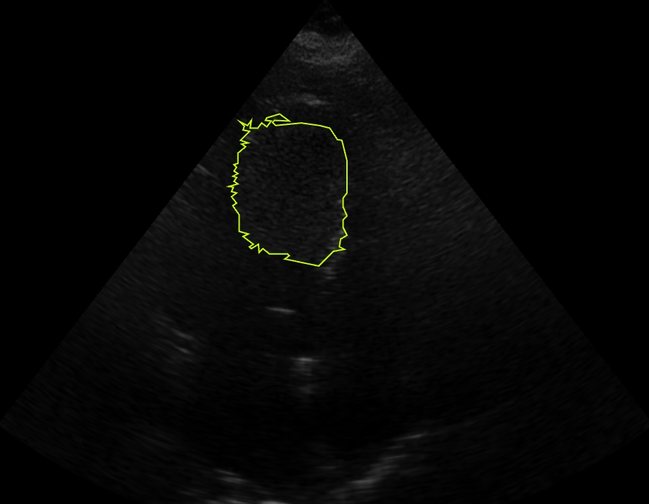
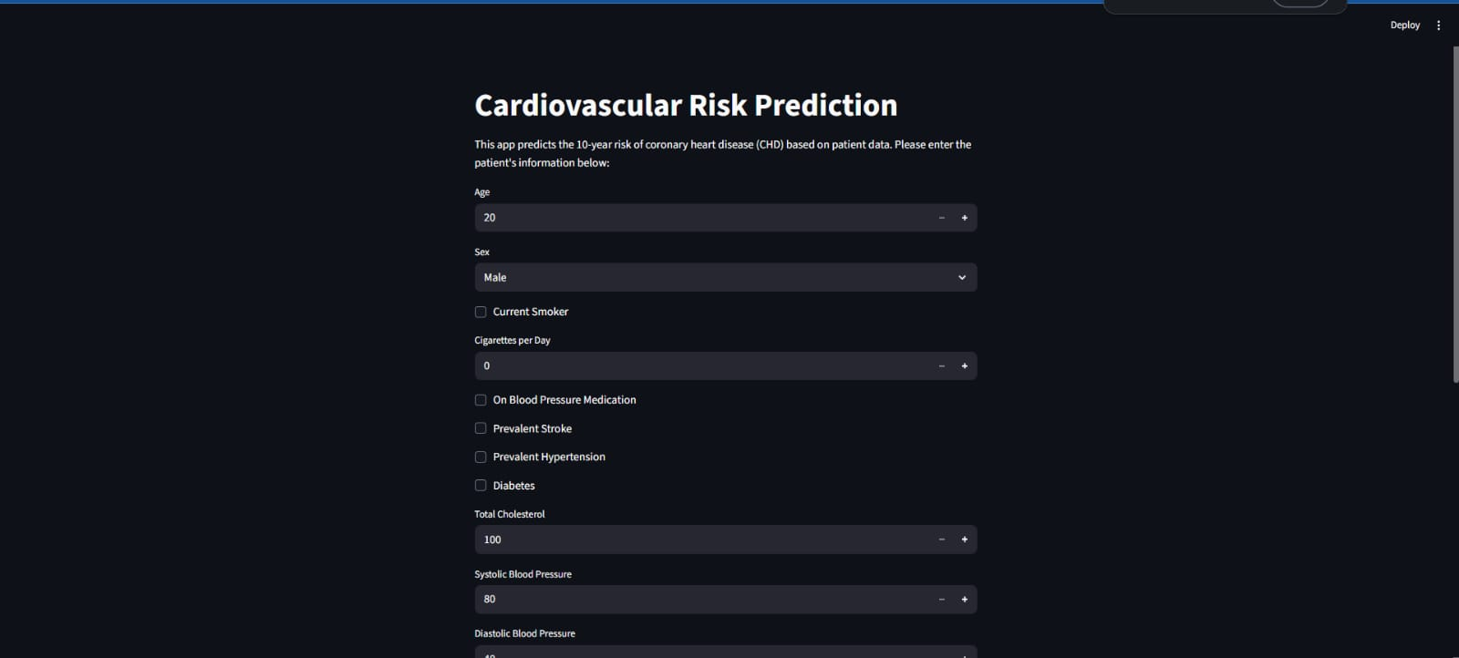
RESULT
Screenshot/Video of Outcome:

Slide 6
IMPACT
Increases awareness about heart health and risk factors.
Encourages adoption of wearable technology for continuous health monitoring.
Facilitates large-scale health data collection for research and public health policy.
Helps reduce disparities in healthcare by providing affordable risk assessment tools.
Promotes mental well-being by reducing anxiety through continuous monitoring and reassurance.
Supports healthier aging by tracking cardiac health trends over time.
Enables personalized health recommendations based on individual risk profiles.
Enhances community health programs by integrating wearable data insights.

Slide 7
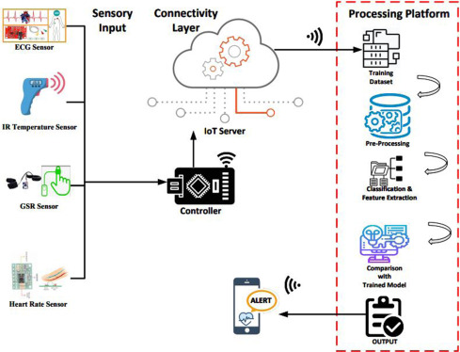
BLOCK DIAGRAM

Slide 8
LITERATURE
Title of the paper | Authors | Journal name & Year | Inference
Cardiac Risk Scoring with ML Algorithms Predicting Cardiac Events Using Wearable Devices | Smith et al. Lee & Patel | IEEE TBE, 2024 JMIR, 2023 | ML models improve prediction of at-risk patients using health data Wearables plus ML can identify early warning signs for heart issues

Slide 9
𝕋𝕙𝕒𝕟𝕜 𝕐𝕆𝕌

